Slide 1
Clinically-relevant dissolution specifications, implication for use in the post-approval setting & tension with F2 similarity testing
Physiologically Based Biopharmaceutics Modelling Conference 2024:
"PBBM - Best Scientific Practices to Define Drug Product Performance: Latest Regulatory and Industry Perspectives"
Paul A Dickinson

Slide 2
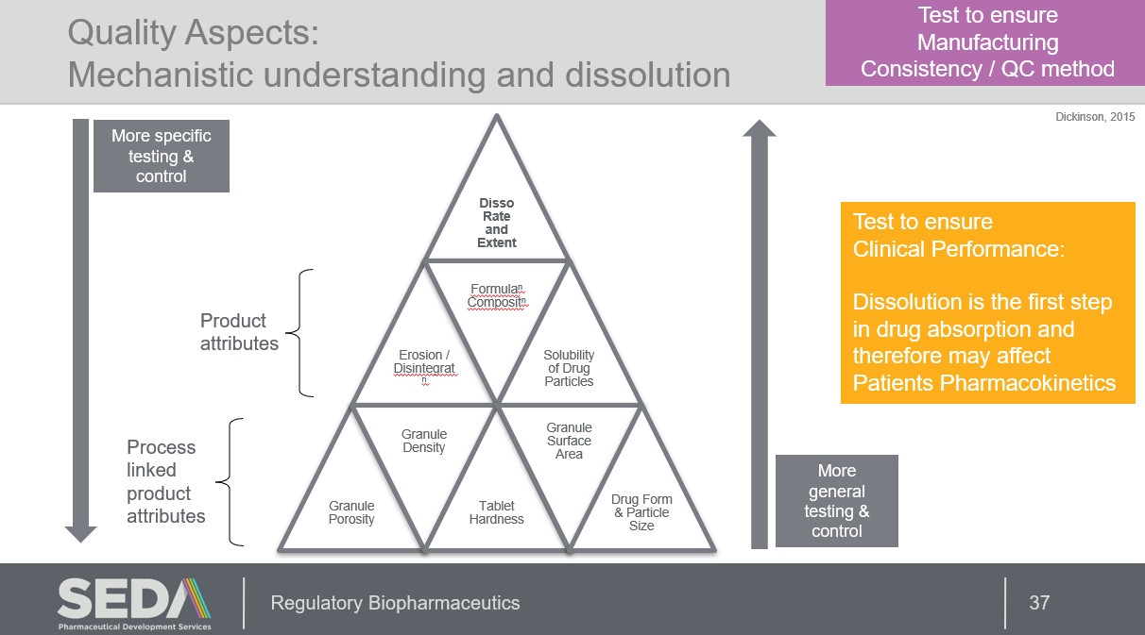
Objective \
What is the value of a clinically-relevant dissolution specifications in the post-approval setting?
And what are tensions and challenges?
  Can we disconnect ‘facts’ from ‘emotions’ to find a common understanding
Focus on dissolution but concepts likely valid for dissolution input into PPBM models (IVIVC?)
Key concepts:
Product Specific SUPAC / MyPAC
BCS1/3 like product risk
Context of use and totality of data

Slide 3
Pre-approval value of CRDS
Specification set on clinical performance:
  In vivo difference: dissolution test conditions should be chosen which allow discrimination between acceptable and non-acceptable batches by setting a suitable specification
  Only acceptable in vivo behaviour: fastest and slowest dissolution bioequivalent to the reference product, specification may be set based on the in vitro dissolution profile of the side batch with the slowest dissolution
Can reduce discussion about the dissolution test conditions and lead to early agreement on dissolution conditions and specifications
  Substantially derisks the drug product dossier
Reflection paper on the dissolution specification for generic solid oral immediate release products with systemic action (europa.eu)

Slide 4
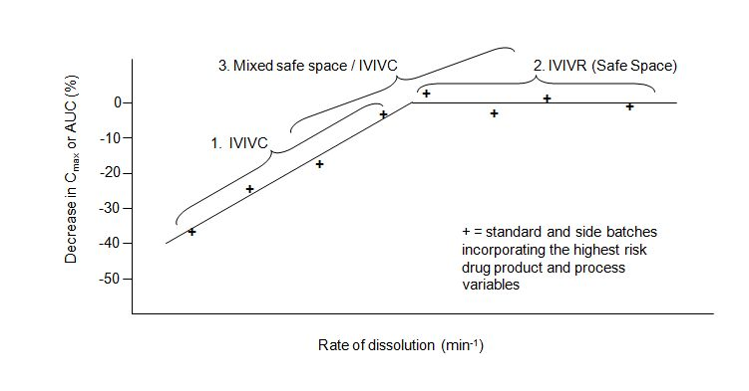
Terminology and context
BCS has conservative limits on solubility (and dissolution): because allows biowaiver without clinical data.
CRDS: limit this to BCS2 and BCS4 compounds in IR products
Reflection paper on the dissolution specification for generic solid oral immediate release products with systemic action (europa.eu)
Dissolution Testing and Acceptance Criteria for Immediate-Release Solid Oral Dosage Form Drug Products Containing High Solubility Drug Substances Guidance for Industry (fda.gov)
For methods where limited / no in vitro discrimination is expected (e.g. BCS1 and BCS3) general expectation to apply F2 testing to prove similarity for a ‘change’
e.g. SUPAR-IR and ICH M9
No F2 if very rapid dissolution
Is this the case for CRDS when safe space ‘proven’?
or even IVIVC/R if spec has been set to discriminate acceptable and unacceptable batches?
P.A. Dickinson, T. Flanagan, D. Holt and P.W. Stott (2016) Clinically Relevant Dissolution for Low-Solubility Immediate-Release Products in Poorly Soluble Drugs: Dissolution and Drug Release. pp 511-552. Eds: G.K. Webster J. D. Jackson and R.G. Bell. Pan Stanford Publishing. ISBN 9789814745451 https://doi.org/10.1201/9781315364537
Lower risk BCS2 and 4 compounds and well-designed drug products may have rapid dissolution compared to physiological process and so safe space is a likely outcome.
And limited in vitro dissolution discrimination expected
The regulatory behaviour of a compound in the product changes ……
“BCS1/3 like risk”
“For drug products containing a BCS class I or class III active substances with very high solubility over the physiological pH range and with rapid or very rapid dissolution, it may not always be possible to detect any differences in dissolution behaviour after meaningful changes in relevant formulation, material specifications and/or manufacturing parameters have been made. In these cases the method may be considered to be adequate without further justification or be replaced by a disintegration test; for details see ICH Q6A or VICH GL39”
P.A Dickinson, W.W. Lee, P.W. Stott, A.I. Townsend, J.P. Smart, P. Ghahramani, T. Hammett, L. Billett, S. Behn, R.C. Gibb and B. Abrahamsson (2008) Clinical Relevance of Dissolution Testing in Quality by Design. AAPS J. 10:380-390

Slide 5
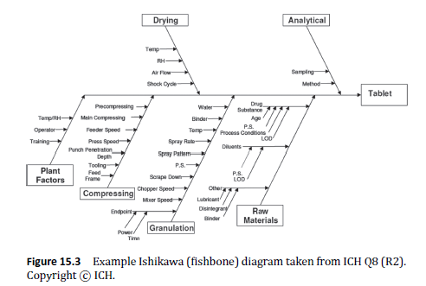
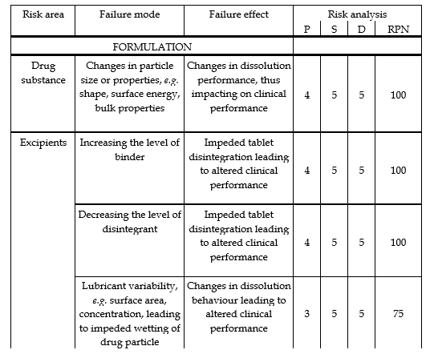
Terminology and context
CRDS: limit this to BCS2 and BCS4 compounds in IR products
Assumption that a product specific QRA has led to the identification of the highest risks to in vivo dissolution (Failure Modes Effects Analysis)
Generation and testing of variants (side batches) with potential failure modes identified as highest risk as part of development
I consider regulatory guidance such as ICH M9, SUPAC-IR and SUPAC-MR to be generally applicable* risk assessments based on science and societal experience/data
*to any drug product
P.A. Dickinson, T. Flanagan, D. Holt and P.W. Stott (2016) Clinically Relevant Dissolution for Low-Solubility Immediate-Release Products in Poorly Soluble Drugs: Dissolution and Drug Release. pp 511-552. Eds: G.K. Webster J. D. Jackson and R.G. Bell. Pan Stanford Publishing. ISBN 9789814745451 https://doi.org/10.1201/9781315364537

Slide 6
How can CRDS be utilised in a post approval setting? Context Of Use
I we accept my assumption this is limited to BCS 2 and 4 compounds – Regulators Viewpoint: a priori high risk!
Let look at potential extremes in the post approval application of CRDS.
Extreme 1
  All changes can be qualified without BE study
  New product only has to meet CRDS specification (single method)
Extreme 2
  Only SUPAC-IR level 2 changes or equivalent can be justified without BE study based only on CRDS dissolution conditions
  New product proved similar via F2 testing
Regardless of whether safe space based CRDS or discriminating acceptable unacceptable batches based CRDS
Only applies to CRDS based on discriminating acceptable unacceptable batches

Slide 7
Let’s contrast each of these pairs of bullets

Slide 8
Pair 1
Statement Pair | Comments
All changes can be qualified without BE study | Seems radical but SUPAC-IR and SUPAC-MR acknowledges Level 3 changes may be waived with IVIVC But am I happy that the dissolution method is suitable for these changes? Dry granulation to wet granulation Soluble filler to insoluble filler When we think about this more perhaps, we are worried these changes will fundamentally affect the dissolution mechanism / characteristics of the product. Such that any previous relationships are no longer valid
Only SUPAC-IR level 2 or equivalent changes can be justified without BE study based only on CRDS dissolution conditions | Conservative approach offers limited regulatory relief post approval – introduction already based on dissolution (less profiles). But more likely constrains changes to those that have previously been assessed. Or does it?

Slide 9
Pair 1
We don’t know what the correct answer is.
SUPAC-IR is a risk assessment based on the state of the knowledge at the time and is generic covering all products.
But we have a product specific dissolution method built on highly specific data to that product (informed by QRA, FMEA and experimental work)
Potential solution:
  As part of the original approval describe the type of changes where the dissolution method and specification is still likely to be relevant
  In the form of a QRA
  Example if API particle size was constrained in the initial submission and not investigated in the CRDS work up can any API characteristics changes be supported?
  This is analogous to FDA IVIVC guidance
  Mutually agreed during review
“Product Specific SUPAC / MyPAC”

Slide 10
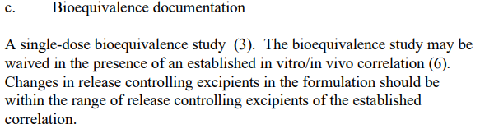
SUPAC-MR
Risk assessment for the continued validity of the dissolution test as a surrogated for clinical performance.
This is CRDS based on IVIVC
COMPONENTS AND COMPOSITION — RELEASE CONTROLLING EXCIPIENT
Level 3 Change .
SUPAC-MR: Modified Release Solid Oral Dosage Forms Scale-Up and Postapproval Changes: Chemistry, Manufacturing, and Controls; In Vitro Dissolution Testing and In Vivo Bioequivalence Documentation | FDA

Slide 11
Pair 2
Statement Pair | Comments
‘Changed product/process’ just has to meet CRDS specification (single method) | Only interested in clinical performance so yes, meeting specification means batches are acceptable: Safe space Specification set on unacceptable batches Or IVIVC a dissolution profile that results in ≤X% changes in mean C_{max}/AUC
‘Changed product/process’ proved similar via F2 testing (if disso slower than 15 mins) | Just QC media or also pH 1.2, 4.5 and 6.8? the changed product to have the same pharmaceutical quality Applying F2 allows maximises the chances that the profiles are qualitatively and quantitatively similar: F2 test controls mean difference of profiles to <10%

Slide 12
Pair 2
For me harder to distil the science/facts from emotion for this pair.
If there is a Product Specific QRA (on forward applicability of dissolution test) in place, then it seems to me from a patient viewpoint changed product just needs to meet specification.
  I think some of anxiety we feel might come from unknown knowns or unknown unknowns (i.e a general uneasiness that something might go wrong)
But BCS2/4 and these are Regulatory high risk for clinical performance – need to be cautious
  However, hasn’t the CRDS reduced this product risk to BCS1/3 level?
What about pharmaceutical quality - if slower dissolution is this a degradation of Quality - even if it has no impact on the patient?
  Onus on manufacturer to show how the changes enhance pharmaceutical quality?
  Robustness of supply could be an important uplift in Pharmaceutical Quality
    As long we are ‘confident’ patient performance isn’t compromised

Slide 13

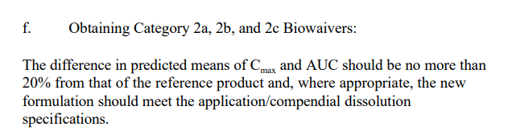
FDA IVIVC Guidance
“In vitro dissolution testing is important for (1) providing process control and quality assurance; (2) determining stable release characteristics of the product over time; and (3) facilitating certain regulatory determinations (e.g., absence of effect of minor formulation changes or of change in manufacturing site on performance). In certain cases, especially for ER formulations, the dissolution test can serve not only as a quality control for the manufacturing process but also as an indicator of how the formulation will perform in vivo. Thus, a main objective of developing and evaluating an IVIVC is to establish the dissolution test as a surrogate for human bioequivalence studies, which may reduce the number of bioequivalence studies performed during the initial approval process as well as with certain scale-up and postapproval changes.”
IVIVC recognises these challenges
But also recognises F2 testing may not be the only way to look at this
Extended Release Oral Dosage Forms: Development, Evaluation, and Application of In Vitro/In Vivo Correlations
X:TRANSFERGUIDANCEFINALX6FNL.PDF (fda.gov)

Slide 14
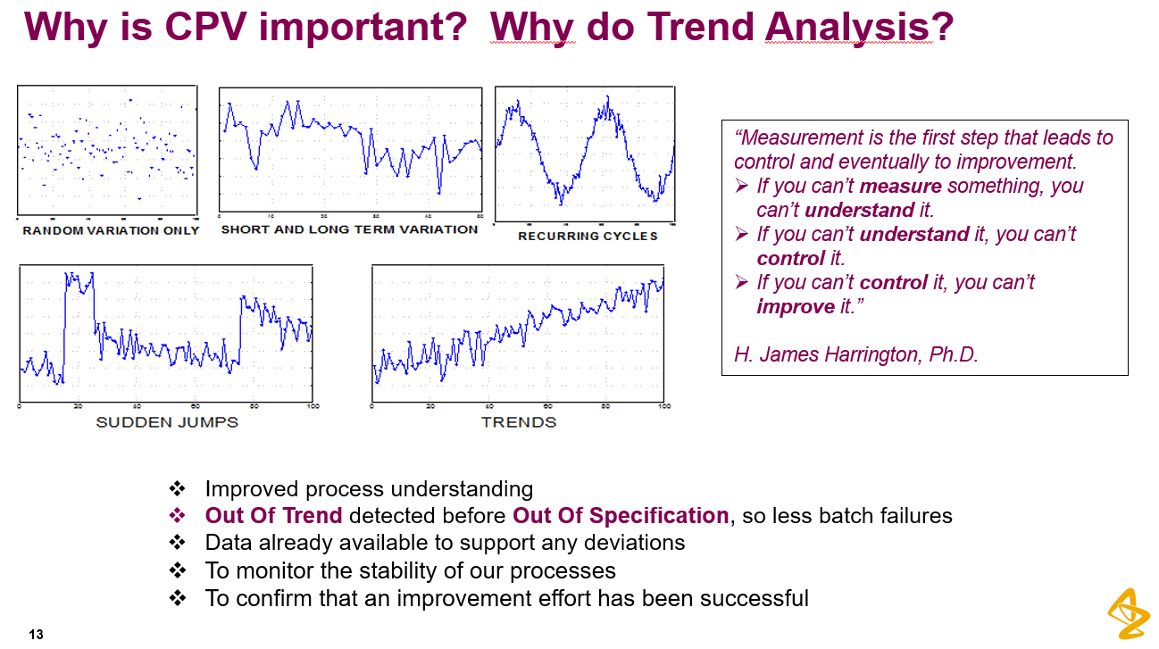
2 Methods and /or CPV
Can the quality angle be dealt with through having 2 methods one for routine release / process monitoring (pharmaceutical quality) and one for clinical performance?
Maybe particular desirable if CRDS is via biorelevant media and PBBM
Or
Is CPV a better context in which to think about pharmaceutical quality rather than ‘one-off’ comparisons
David Holt, Real World Control Strategies:
Applying Continued Process Verification (CPV) to understand manufacturing process performance. Alderley Park, 2016.

